Slide 1



DROID SCANNER :
AN APP SECURITY MANAGEMENT SYSTEM
Supervised By
Prof. Md. Zulfiquar Hafizz
Presented by:
Salsabila Zaman 1443
Md. Shaikhul Islam 1438

Slide 2

OVERVIEW
01
02
03
Introduction
Motivation
Project Description
04
05
06
App Analysis
Strategy
Timeline

Slide 3



INTRODUCTION TO
DROID SCANNER
In today's digital landscape, mobile security is paramount. The Droid Scanner App Management System enhances security by providing tools to safeguard sensitive data. This presentation will explore its features and implementation strategies to ensure robust protection against mobile threats.

Slide 4
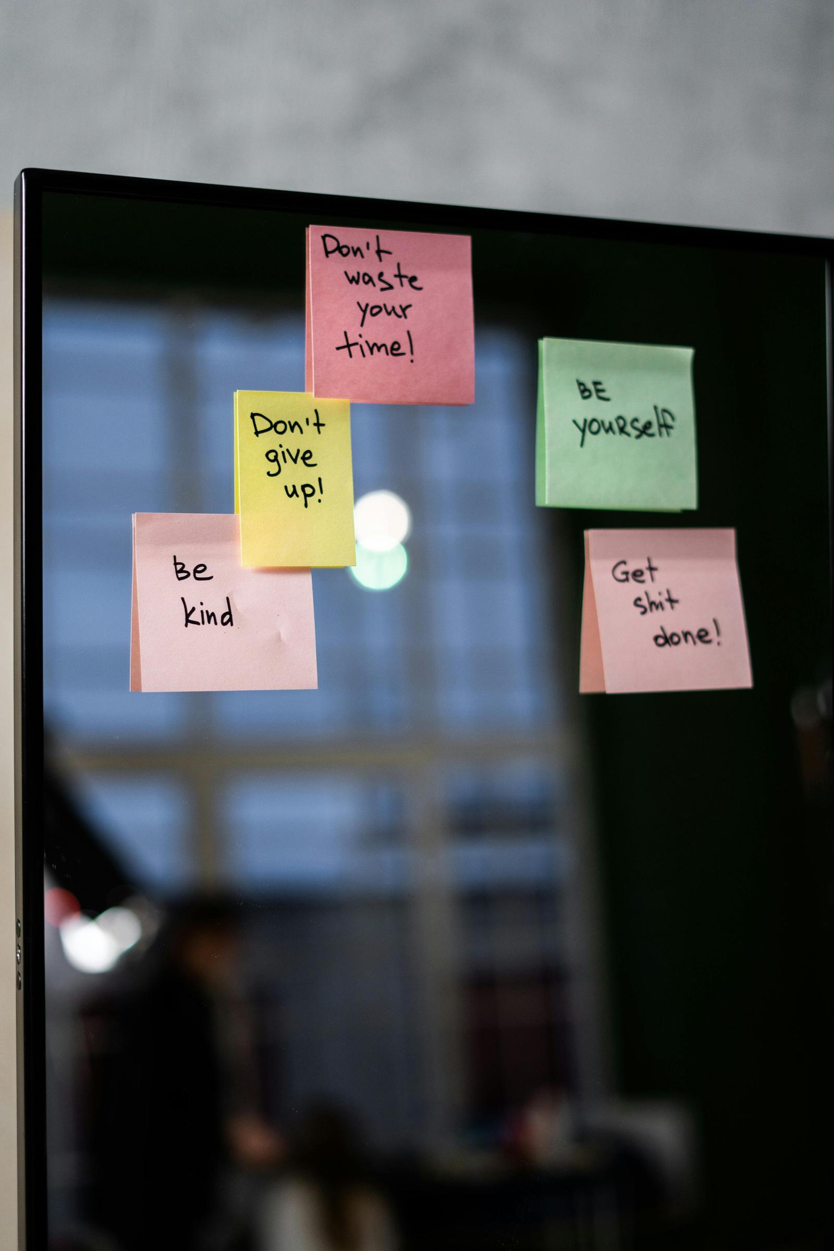
MOTIVATION
Android malware can be embedded in
a variety of applications such as banking apps, gaming apps, lifestyle apps, educational apps, etc. These malware-infected apps can then compromise security and privacy by allowing unauthorized access to privacy-sensitive information, rooting devices, turning devices into remotely controlled bots, etc.

Slide 5
Stakeholders:
1. End Users : Primary Mobile Device Users: General users seeking to secure their devices.
2. Corporate and Enterprise Users : Protecting organization-wide devices.
3. Mobile Device and App Developers : Ensuring apps meet security standards, Certifying app security before launch.
4. Educational and Research Institutions Cybersecurity Programs: Training students with hands-on malware detection.
5. Legal and Compliance Teams: Ensuring compliance with data privacy regulations.

Slide 6
Features :
Malicious App Detection
APK Extraction
Permission & Intent Viewer
User-Dedicated Database
User Dashboard

Slide 7

PROJECT DESCRIPTION
Malicious App Detection:
Benign App Data Collection:
Extract .apk file.
Analyze permissions and intents, storing them in a database.
Malicious App Data Collection:
Source data from security research platforms.
Extract and filter relevant data based on similarities with benign apps.
Combine malicious and benign data in one database .
Model Training:
Train a machine learning model to classify apps as malicious or benign.
Update the database with new data.

Slide 8
PROJECT DESCRIPTION
Exciting Features:
Multiple Scan Options: Full scan, quick scan.
Custom App Management: Whitelist trusted apps, blacklist risky ones, and block known malicious apps using a predefined list.

Slide 9

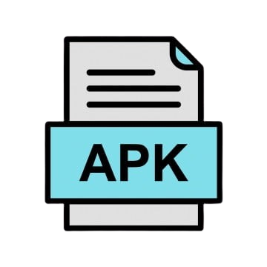

App Analysis
App Samples ( Benign or Malicious )
ApkTool
Permissions
Intents
Manifest File
AndroidManifest.xml)

Slide 10
Steps to extract .apk files
Retrieve the Package Name of the Target App
API: PackageManager
Method: getInstalledPackages(int flags)
Retrieve the APK File Path
API: PackageManager
Method : getApplicationInfo(String packageName, int flags)

Slide 11
Tools
1. Programming Languages: Python, Java
2. Frontend Tools: HTML, CSS, JS
3. Backend Tools: Django, REST API
4. Database: PostgreSQL
5. Other Tools: Git (for version control), Postman

Slide 12

Strategy
1. Have defined objectives.
2. Develop backend and frontend parallelly.
3. Conduct static analysis on APK files.
4. Form the primary database similar to the dataset.
Focus
5. Build API for integration.
6. Create wireframes attractively so that people feel more interested.
7. Design secure user databases to avoid complications.
8. Train and verify the ML model.
9. Perform testing continuously.
10. Follow the agile approach to develop a user dashboard.

Slide 13
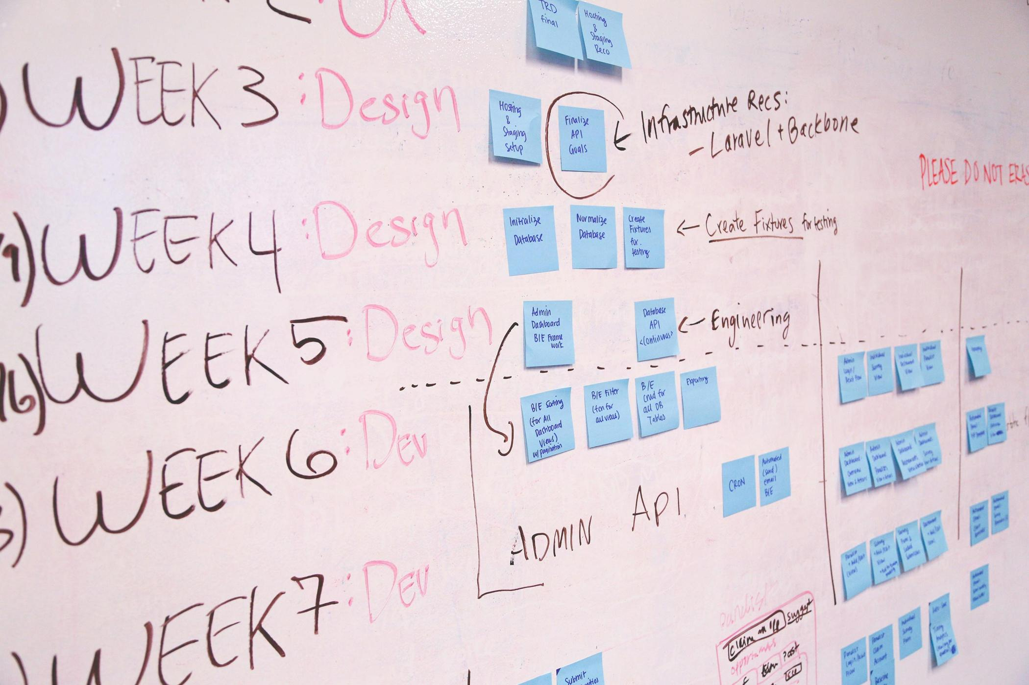

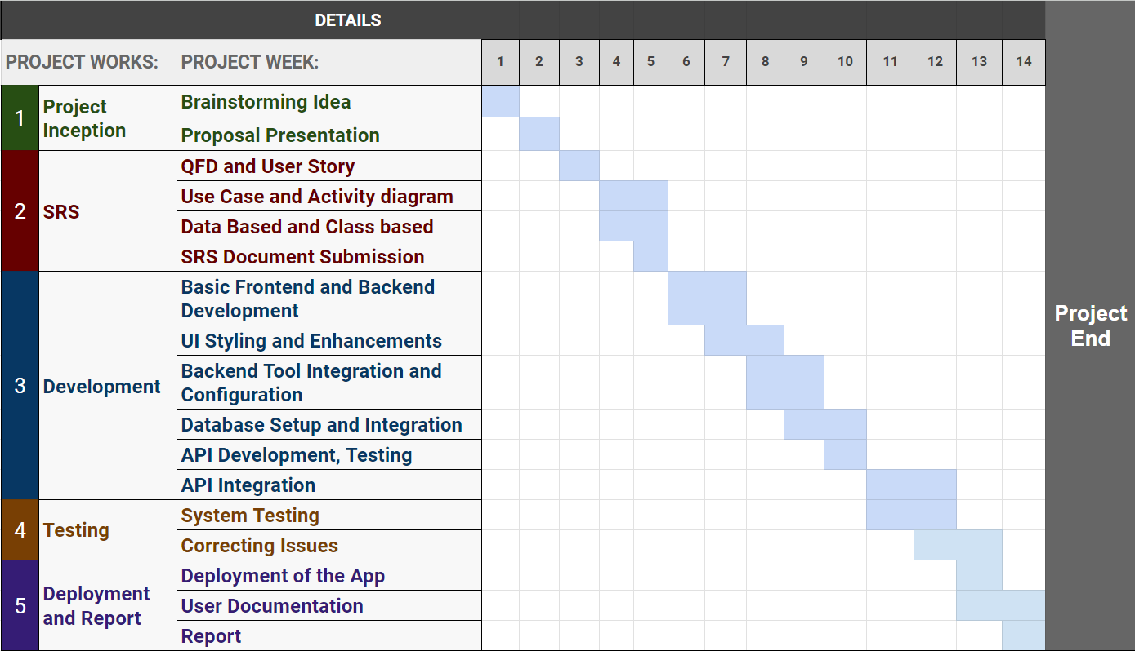
TIMELINE

Slide 14

Thanks For your
Kind Patience..
Any Question ?

